Slide 1
Capstone Project – FIFA World Cup 2018 Twitter Analysis
Miles Rousseau
10/20/2022

Slide 2
Introduction
The FIFA World Cup is one of the most watched sporting events in the world, and millions of fans worldwide chime in on Twitter to voice their opinions on the proceedings. With the next world cup approaching this November, I will be looking into what fans on Twitter had to say about the last installment of the World Cup in 2018.
The goal of this analysis is to gain insights about the likes and dislikes fans expressed on Twitter in order to create suggestions that FIFA can use to further improve the fan experience.

Slide 3
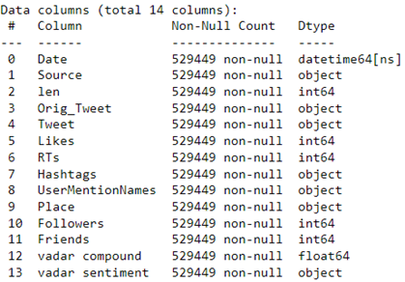
Dataset
The data is a collection of 530K tweets starting from the Round of 16 until the Final, 6/29/22 until 7/15/22.
The dataset was cleaned, and feature engineered.
The main column of interest is the actual tweet string.
Supplementary columns included the location from where the tweet was posted, the hashtags used and the users mentioned.

Slide 4
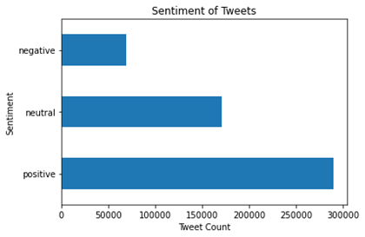
Analysis
Vader Sentiment analyzer was used to classify each row as positive, negative or neutral.
54.7% of all tweets in the dataset were positive, 32.1% were neutral and 13.1% were negative.
After each tweet was classified, the tweet and its hashtags and mentions were vectorized to efficiently investigate the relationship between various topics and the sentiment.

Slide 5
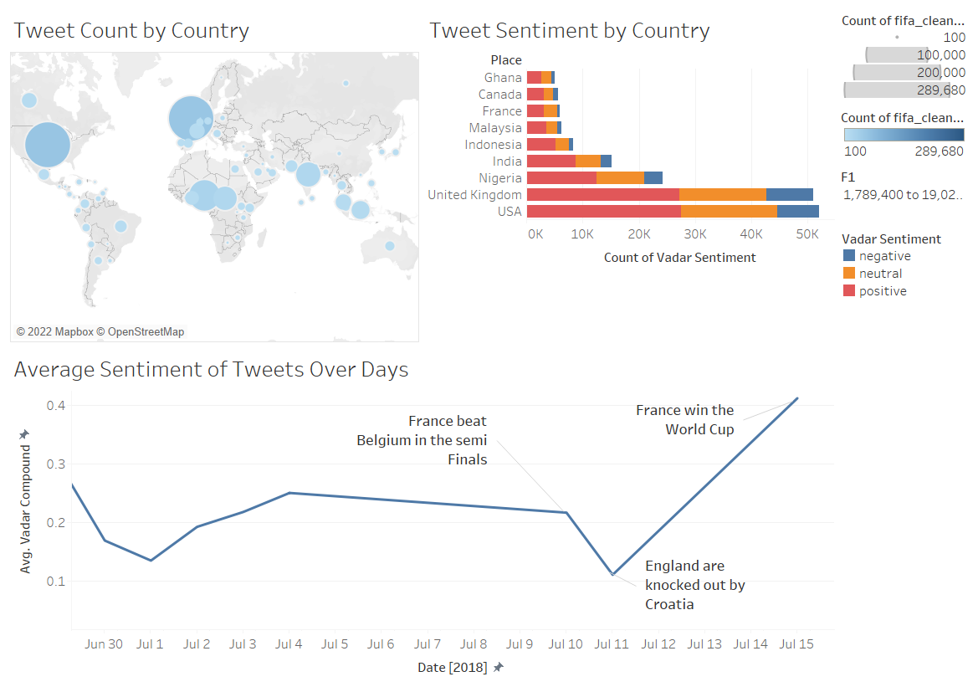
Insights

Slide 6

Actions
The first installment of using VAR was positively received and should continue in FIFA organized tournaments.
80% of tweets about VAR had positive or neutral sentiments, when compared to the overall topic of refereeing which had 64%.

Slide 7
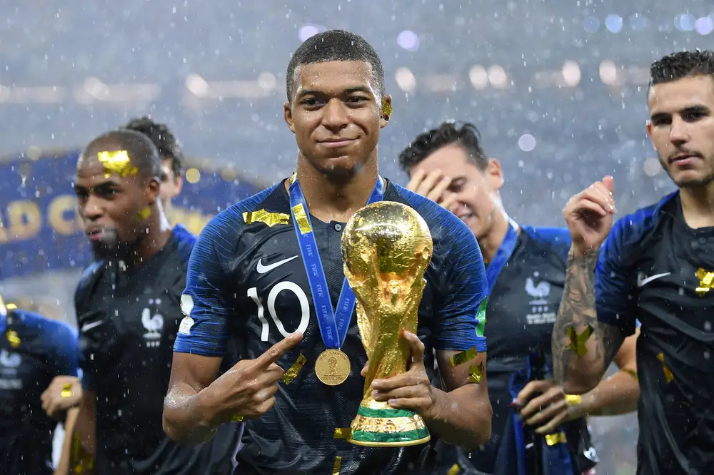
Actions
Kylian Mbappe should be used as the new poster boy for the marketing of the Qatar World Cup.
Mbappe was the most mentioned player in the entire dataset and had 15,000 positive tweets in which he was mentioned, significantly greater than the traditional star player Messi who only had 7,000 positive tweets.

Slide 8
Next steps
Further topic exploration.
Automated easy to use topic visualization tool

Slide 9
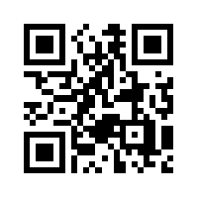
Contact
linkedin.com/in/miles-rousseau
milesrousseau97@gmail.com

